Slide 1

School of Computer Science and Engineering
University of Petroleum & Energy Studies
Dehradun - 248001
2019
Email Server configuration and customization

Slide 2
Email Server Configuration & Customization
Minor 1
Aug 2019-Dec 2019

Slide 3
Email Server
An email server or a mail server is a computer that serves the functionality of a mail transfer agent (MTA).
Basis on statistics report on e-mail account in 2014, totalled 4.1 billion email accounts were actively used.
Most of the internet system uses SMTP (Simple Mail Transfer Protocol) for transfer of mail from one user to another. It is a push protocol i.e. it is used to send the mail.
The client SMTP is the one which initiates the session, and the receiver-SMTP is the one which responds to the session.

Slide 4
SSL & CSR
SSL stands for Secure Socket Layer.
It is a standard technology for securing the internet connection and also safeguarding any kind of sensitive data that is sent between two systems.
SSL uses encryption algorithms to scramble data in transit.
SSL works over port number 465.
CSR stands for Certificate Signing Request.
CSR is the first step towards getting your SSL certificate.
The CSR contains information which is useful to create your certificate by Certificate Authority.

Slide 5
Protocols and essentials
In SMTP, there is a direct link between the sender's client SMTP (who wants to send the mail) and the destinations host SMTP.
The SMTP server keeps the mail until and unless it is successfully copied to the receiver's SMTP.
=) sending - ports (ssl) – 465
POP 3 – acts as the receiving protocol for the mailing server.
POP can be thought of as a "store-and-forward” service.
=) Receiving - ports (ssl) – 995
POSTFIX: It is a free and open mail transfer agent (MTA) that relays mail between different mail servers and the internet. It routes and delivers the email. It is released under the IBM Public License 1.0 which is a free software license.

Slide 6
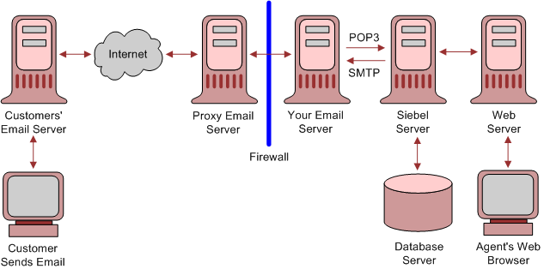
Email Server Architecture
The e-mail system is an integration of several components such as hardware and software, services and protocol that support the communication between user and server, or vice versa.

Slide 7
Problem Statement
A lot of companies nowadays have their own privacy factors, in which they prefer to keep their delicate data inside their organizations.
The Proposed work attempts to provide an improvement over basic email servers to add functionalities like log maintenance (Back up/ Deletion), algorithm to inspect incoming traffic and provide ease of access to the flagged mails.

Slide 8
Objective
The Perform Customization of an email server to serve as per the constraints identified for an organization
Maintain a log of all mails (sent/ received) from the server.
To automate the process of Backup and deletion of logs.
To inspect sensitive content in the mail and add constraints respective to it.
Applying searching and sorting algorithm to buffer list for easy access.
Filtering the content and providing the security to the process by signing SSL, TSL Certifications.

Slide 9
Project requirements
Hardware Requirements
Computer system
Minimum 1GB Ram
Minimum 40GB Hard disk
Software Requirements
Linux OS (Ubuntu Distribution)
GCC
PostFix
SSL
Smtp/pop 3

Slide 10
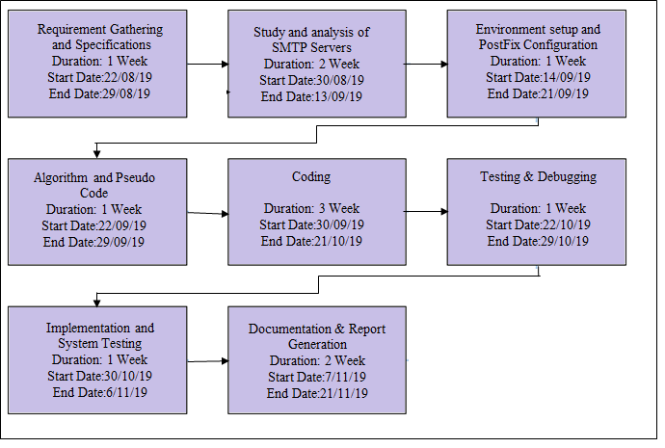
Program Evaluation Review Technique chart

Slide 11
THANK YOU for precious time …

